Slide 1


Requirements Analysis
Disaster Management System
GROUP 25
1

Slide 2


Introduction:
The Requirements Analysis phase within the project seeks to capture, prioritize, and analyze requirements to ensure clarity, consistency, and feasibility, ultimately contributing to the system's effectiveness in disaster management.
Importance of Requirements Analysis:
Foundation of Project Success
Ensures Alignment with Stakeholder Needs
Minimizes Risks and Delays
11

Slide 3
User Requirements
User Needs and Expectations
Usability and Accessibility
Feedback from Stakeholders
Prioritized User Requirements
User Authentication and Access Control
User-friendly Interface and Accessibility
Emergency Reporting and Incident Management

Slide 4

System Requirements
Scalability and Performance
Integration
and Interoperability
Technical Feasibility
Prioritized System Requirements
Scalability and Performance Optimization
Integration with External Systems

Slide 5
Platform Requirements
Criteria for Evaluating Platform Requirements
Functionality and Features
Accessibility and Usability
User Reach
Prioritized platform Requirements
Mobile Applications on Android and iOS Platforms

Slide 6



Offline and Online Capabilities
Criteria for Evaluating Offline and Online Capabilities:
Accessibility in Emergency Situations
Usability and Functionality in Disaster-Affected Areas
---------------
--------------------------
Explanation of Offline Capabilities
Access to Critical Information Without Internet Connectivity
Enhanced Usability and Accessibility in Remote Locations

Slide 7
Requirements Consistency and Completeness
Importance of Consistency and Completeness:
Minimizes Ambiguity and Confusion
Ensures Alignment with Project Objectives
Facilitates Effective Communication
Analysis Findings:
Consistency Across Requirements
Clear Dependencies Identified
Importance of Requirements Analysis:
Foundation of Project Success
Ensures Alignment with Stakeholder Needs
Minimizes Risks and Delays
11

Slide 8
Feasibility Analysis
Technical Feasibility
Financial Feasibility

Slide 9
Impact Analysis
Project Scope
Schedule
Budget
Changes to requirements may result in expanding or narrowing the project
scope.
Any changes to requirements can affect project timelines
Alterations to requirements can have financial implications, including
additional development costs, resource reallocation, or changes in procurement needs.
IDENTIFICATION OF DEPENDENCIES
Technical Dependencies:
Resource Dependencies
Stakeholder Dependencies

Slide 10


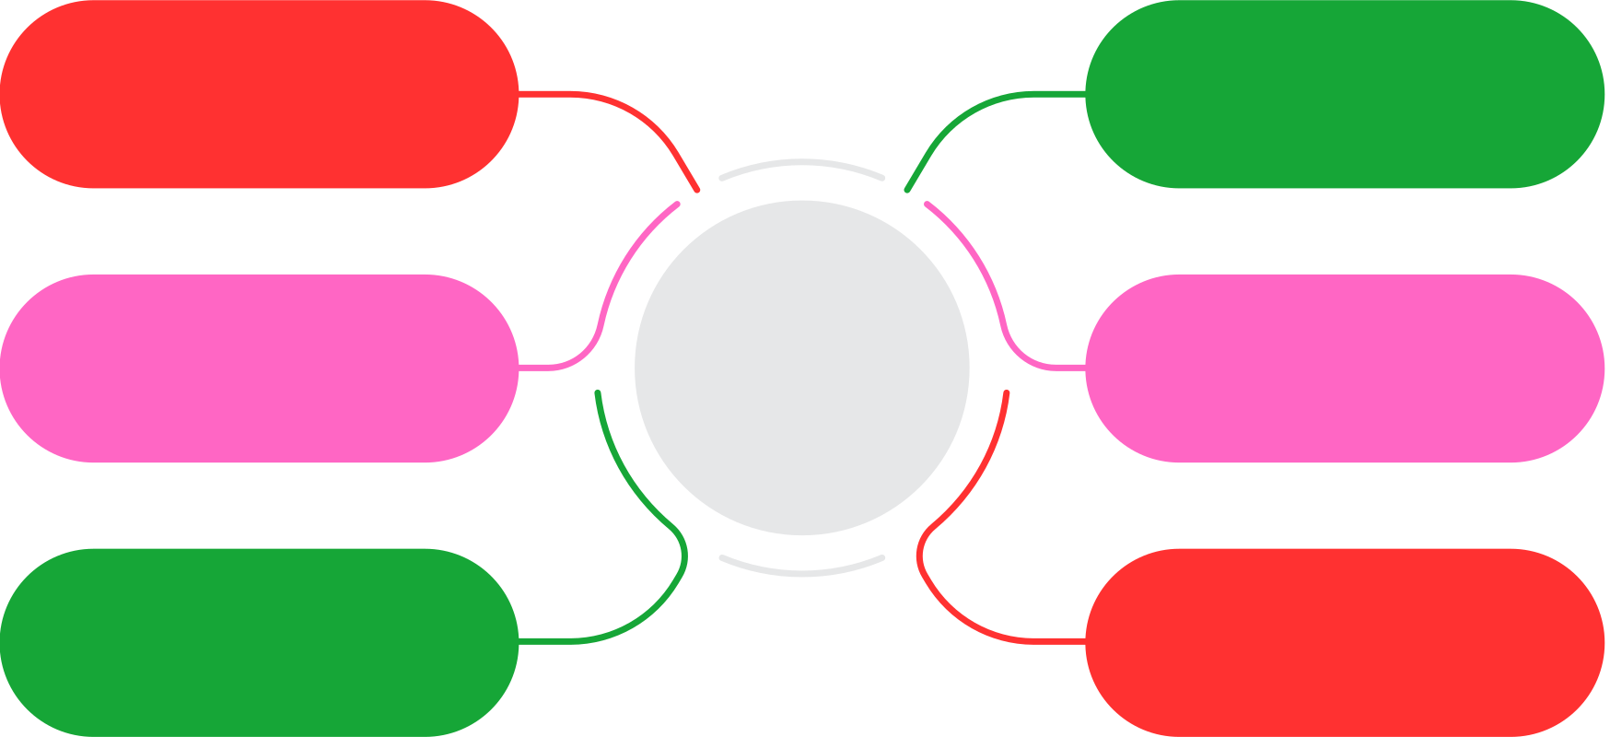
SWOT Analysis
Technological Advancements
Resource Constraints
Expertise and Experience
SW
Complexity of Integration
Stakeholder Support
Dependency on External Factors
Market Demand
Regulatory Challenges
Partnership Opportunities
OT
Security Risks
Technological Advancements
Competitive Landscape

Slide 11
Recommendations
Refinement of Requirements
Stakeholder Engagement
Scope Management
Risk Mitigation
Technology Assessment

Slide 12
Conclusion
The rigorous requirements analysis ensures that our Disaster Management System project is on the right track for success. By thoroughly understanding stakeholder needs and aligning them with project objectives, we minimize risks and ensure clarity in our approach.

Slide 13

THANK YOU

